Slide 1
Matlab程式設計_4_06
助教:金郁善

Slide 2
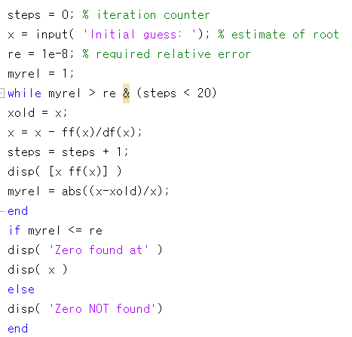


The way to create a function
Practice1.m
df.m
ff.m

Slide 3
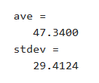
Function with multiple outputs
function [m,s] = stat(x)
n = length(x);
m = sum(x)/n;
s = sqrt(sum((x-m).^2/n));
end
stat.m
values = [12.7, 45.4, 98.9, 26.6, 53.1];
[ave,stdev] = stat(values)
output
main.m

Slide 4
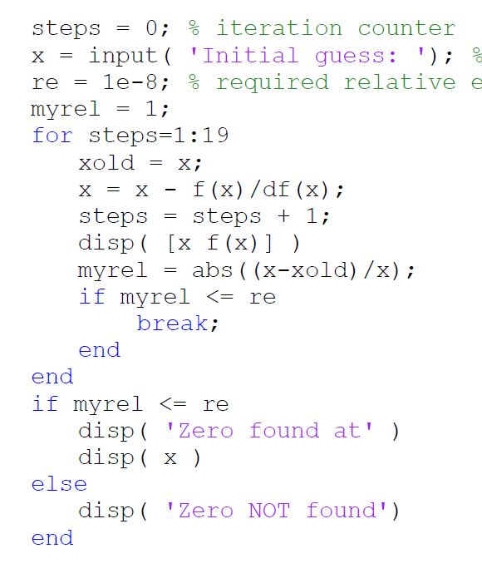
break
break terminates the execution of a for or while loop.

Slide 5



function handle
To create a handle for a function, precede the function name with an @ sign.
Ex) if you have a function called myfunction
f = @myfunction;
output

Slide 6
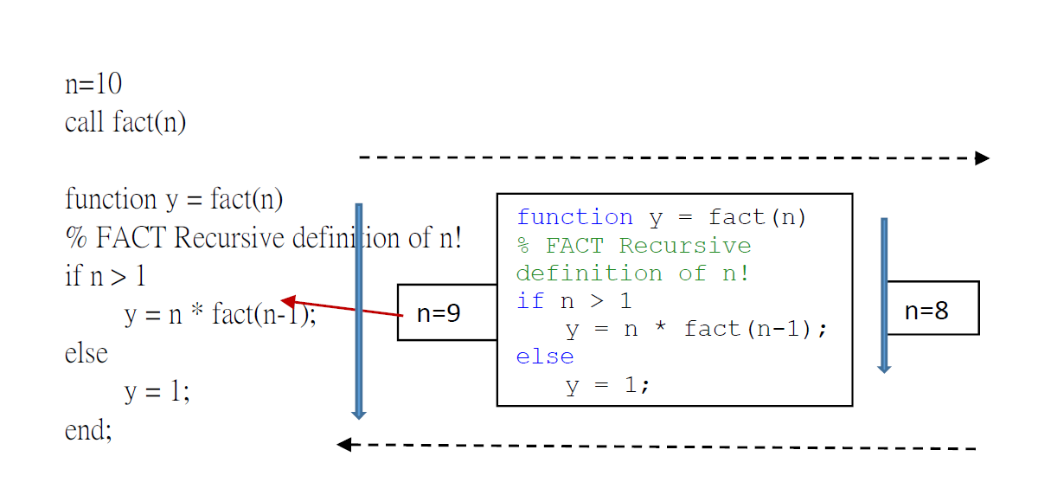
recursion

Slide 7
HOMEWORK

Slide 8
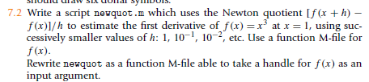

Slide 9
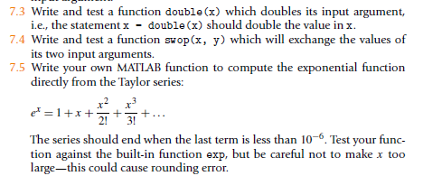

Slide 11
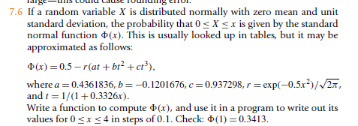

Slide 12
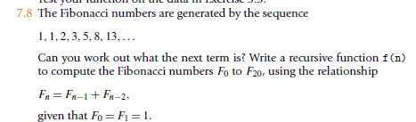

Slide 13
